Slide 2
What is a Kestrel Web Server?
As we already discussed ASP.NET Core is a cross-platform framework. It means it supports to develop and run applications on different types of operating systems such as Windows, Linux, or Mac.
The Kestrel is the cross-platform web server for the ASP.NET Core application. That means this Server supports all the platforms and versions that the ASP.NET Core supports. By default, it is included as the internal web server in the .NET Core application.
The Kestrel Web Server generally used as an edge server i.e. the internet-facing web server which directly processes the incoming HTTP request from the client. In the case of the Kestrel web server, the process name that is used to host and run the ASP.NET Core application is the project name.
As of now, we are using visual studio to run the ASP.NET Core application. By default, the visual studio uses IIS Express to host and run the ASP.NET Core application. So, the process name is IIS Express that we already discussed

Slide 3
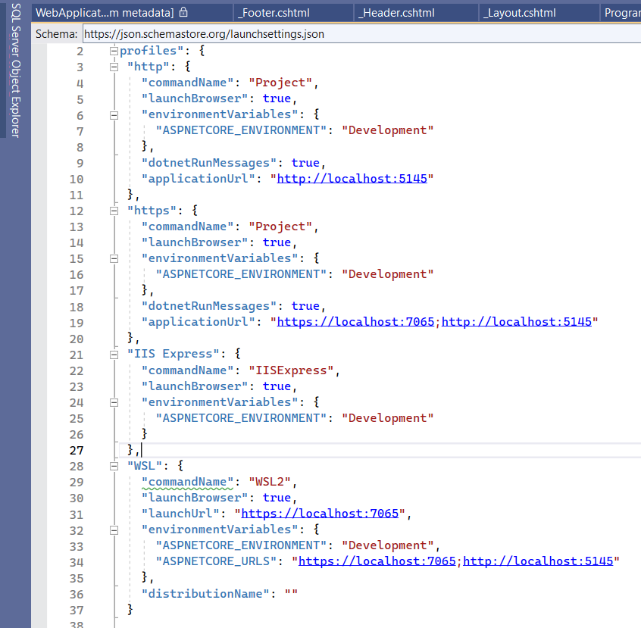
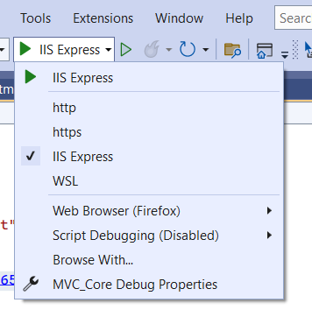
How to run the application using Kestrel Web Server?
Before using the Kestrel server to run our application, let us first open the launchSettings.json file which is present inside the Properties folder of your application. Once you open the launchSettings.json file you will find the following code by default.
we will discuss launchSettings.json in detail. But for now, just have a look at the Profiles section. Here, you can see, we have two sections. One is for IIS Express (IIS Server) and the other one is for the Kestrel server. In visual studio, you can find the above two profiles (IIS Express and FirstCoreWebApplication) as shown below.
If you select IIS Express then it will use the IIS server and if you select FirstCoreWebApplication, then it will use Kestrel Server.

Slide 4
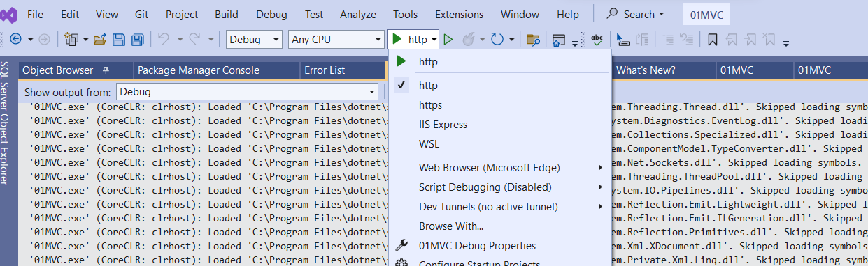
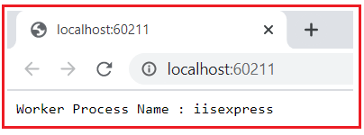
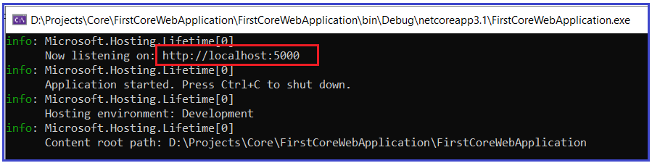
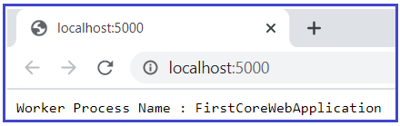
Running the application using Kestrel Server:
Running the application using IIS Express:
In order to use the Kestrel server to run your application in Visual Studio, first, you need to select the
Http profile as shown below.
If you run the application using IIS Express, then it will use the URL and port number mentioned in the iisSettings of your launchSettings.json file.
To prove this run the application using IIS Express and see the output as shown below.
Once you select the Http,
now run the application. Here, we need to observe two things.
First, it will launch the command prompt and host the application using the Kestrel server as shown below.
Here, you need to focus on the URL and port number and it should be the URL and port number mentioned in your Http profile of launchSettings.json file.
Secondly, it opens the default browser and listening to that URL and Port Number as shown below.
Note: In our example, for IIS Express the port number is 60211, and worker process is iisexpress while for Kestrel server the port number is 5000 and the worker process name is FirstCoreWebApplication (It is nothing but your application name)

Slide 5

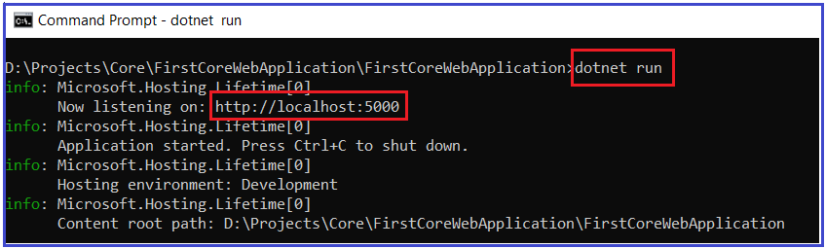
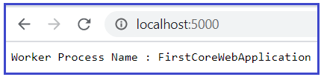
How to run .NET Core application using .NET Core CLI?
We can also run the ASP.NET Core application from the command line using the .NET Core CLI. The CLI stands for Command Line Interface.
When we run an ASP.NET Core application using the .NET Core CLI, then the .NET Core runtime uses Kestrel as the webserver.
First, open the Windows Command Prompt. To do so, open the run window and then type cmd and click on the enter button which will open the command prompt. Then you need to change the directory to the folder which contains your asp.net core application. My project is present in the “D:\Projects\Core\FirstCoreWebApplication\FirstCoreWebApplication” folder so I change the current directory to my project file by using the following command.
Once you change the directory to your project folder, then execute the “dotnet run” command as shown in the below image.
Here, in my case, the application is available at http://localhost:5000.
If you remember this port is configured in the launchSettings.json file of your application inside the FirstCoreWebApplication profile which is nothing but the profile for the Kestrel server. Now open the browser and navigate to the http://localhost:5000 URL and It should display the worker process name as dotnet as shown below.

Slide 6
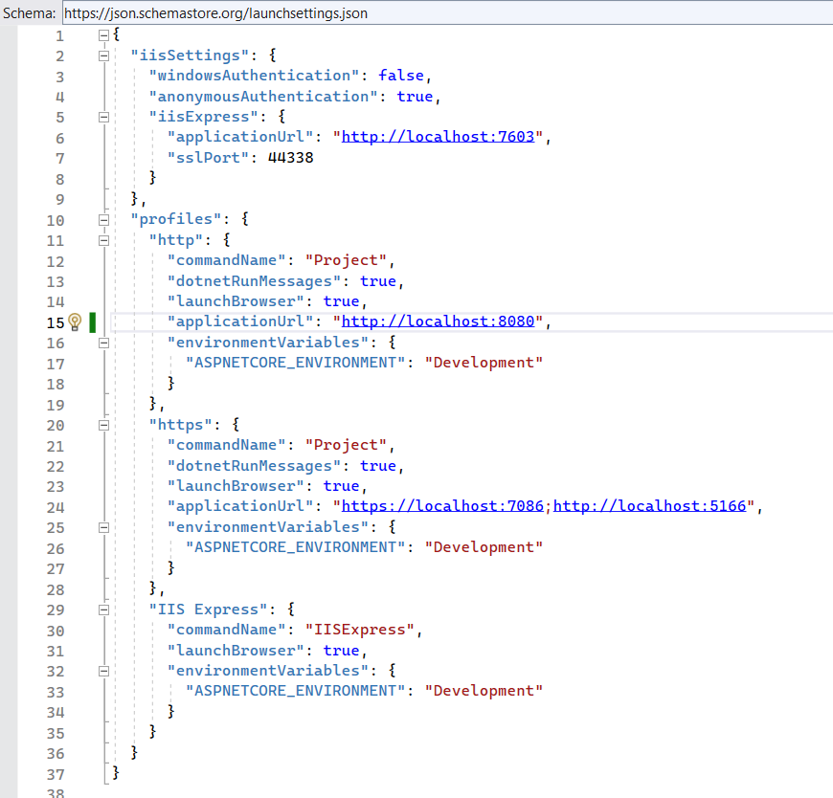
Changing the Port Number:
you want then you can also change the Port number for Kestrel Server. To do so open the launchSettings.json file and give any available Port number as shown below. Here, I am changing the Port number to 8080.
Now, save the changes and run the application using Kestrel Server and you should see the changed port number in the URL.

Slide 7
Q1. launchSettings.json file which is present inside the ____________folder of your application
Q2. How to change the Port number for Kestrel Server

